Slide 1
Project Name
Local Tourism App
Prepared By:
Chauhan Sanket (13MCAL006)
Internal Project Guide
Ms. Rupal Patel
External Project Guide
Mr. Pranjal Raval
Name of the Company
Affiliated Technologies PVT.LTD

Slide 2
Project Profile
Project Name: Local Tourism App
Type of Application: iPhone Application
Project Description:
  Local Tourism App is an application that showing tourism information in your local area such as attractions, hotels, restaurants, and shopping places. You can easily customize this application as per your conveniences.

Slide 3
Project Information
Definition: | Local Tourism App
Platform: | iOS
Frontend: | X code / Objective c / ASP.NET
Backend: | MS-SQL Server Management Studio 2008 R2
Designing Tool: | Photoshop CS4, GIMP 3.0, draw.io
Developed By: | Chauhan Sanket H. (13MCAL006)

Slide 4
System Study: Existing System
Study of current system.
In the present system only one city details are inserted. So, user can access only that city attraction, hotels information, and other places.
Problems and weakness of the system.
Cannot run this application without internet.
Only single user can accessible.
Difficult to find one or more location.
Sometime difficult to manage user activity.

Slide 5
Proposed System:
In this system different modules are available which all Uses are as an activity in this mobile application project or system, these modules are as follows:
Login
Registration
Attraction
Hotels
Restaurant
Shopping
Theatres
Transportation
About

Slide 6
Scope of the Proposed System:
This iPhone application is used to find users current location using Google map or apple map. User can easily reach own location by selecting application preferred attraction or other places.
This application is very useful for unknown person in the city.

Slide 7
The following are the major operations in this application.
User can use first time this application, registration is required.
User can login using own username and password.
User can select hotels and easily reach their addresses using apple map.
User can select restaurant category and easily reach their addresses using apple map.
User can select attraction category wise such as museum, historical places, temples and garden & lake, and easily reach their using perfect addresses and apple map.
User can select shopping malls inside the city and reach their using address or apple map.
User can select theaters inside the city and reach their using address or apple map.
User can select transportation such as bus station, railway station, and airport inside the city and reach their using address or apple map.

Slide 8
Aim and Objective of the Proposed System :
In this application user can easily re-arranging everywhere.
An Unknown person can easily reach their own address or places using addresses or apple map.
User can easily find own current location.

Slide 9
Feasibility Study:
Operational Feasibility: The application working is quite easy to use and learn due to its simple but attractive interface. User requires no special training for operating the application.
Technical Feasibility: The technical requirement for the application is economic and it does not use any other additional Hardware and Software, but this application runs on only apples product such as iPhone, iPad and consists of iOS. The system can be expanded by adding new feature if necessary in future

Slide 10
Economical Feasibility:
The application being developed is economic with respect to user point of view. The result obtained contains minimum errors and are highly accurate as the data is required. Deploy this application at that time apples term and conditions are follow, and developer must have unique apple ID and their product licenses.

Slide 11
Requirement Specification:
Windows Operating System | Apple MAC OS X
Intel Core series Processor with 2.30GHz | 2 * 2.19 GHz Processor
4 GB DDR RAM | 4 GB DDR RAM
50 GB Free Hard disk Space | 30 GB Free HD Space
Windows 7 or latest version OS | MAC OS X 10.7 or latest version OS
VM Ware Workstation 10.10 | X Code (version depends on your MAC OS X version)
Microsoft Visual Studio 2010 | SQLite Browser
Microsoft Database Studio 2008 R2 | MESA SQLite TOOL
Microsoft Office
Adobe Photoshop CS4
GIMP 3.0

Slide 12
Tools Used To Develop:
X Code
SQLite Browser
Adobe Photoshop
Microsoft Database Management Studio 2008
Microsoft Visual Studio 2012
Microsoft Office

Slide 13
System Modules
Admin Modules
Login
Admin can changes in admin side website that time login in required.
Manage State/City
Admin can add, update or delete state and city information using this module.
Manage Place
Admin can add, update and delete place information using this module.

Slide 14
Manage Category
Admin can add, update and delete category information using this module.
Manage Sub-category
Admin can add, update and delete sub-category information using this module.
Manage Users
Admin can block or unblock users, connected this application using this module.

Slide 15
Client Modules
Registration
User can use this iPhone application first time at that time user registration is required using this module.
Login
If user registration has been completed then user can login this module.
Hotel
User can see list of hotels information, address, and hotel location using this module.

Slide 16
Restaurant
User can see list of restaurant information, address, and restaurant
Location using this module.
Attraction
User can see list of attraction information, address, and location category wise using this module.
Shopping
User can see list of shopping mall information, address, and location category wise using this module.
Theaters
User can see list of theaters information, address, and location using this module.
Transportation
User can see list of transportation information, address, and location category wise using this module.

Slide 17
Admin Side
Diagrams

Slide 18
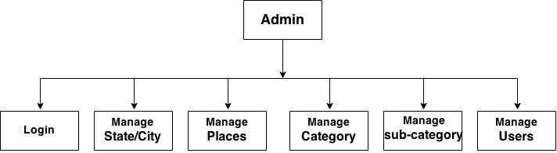
Module Hierarchy.

Slide 19
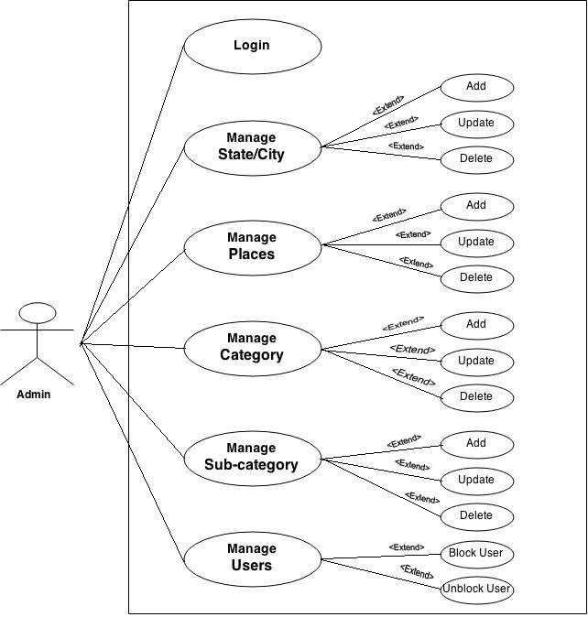
Use case Diagram.

Slide 20
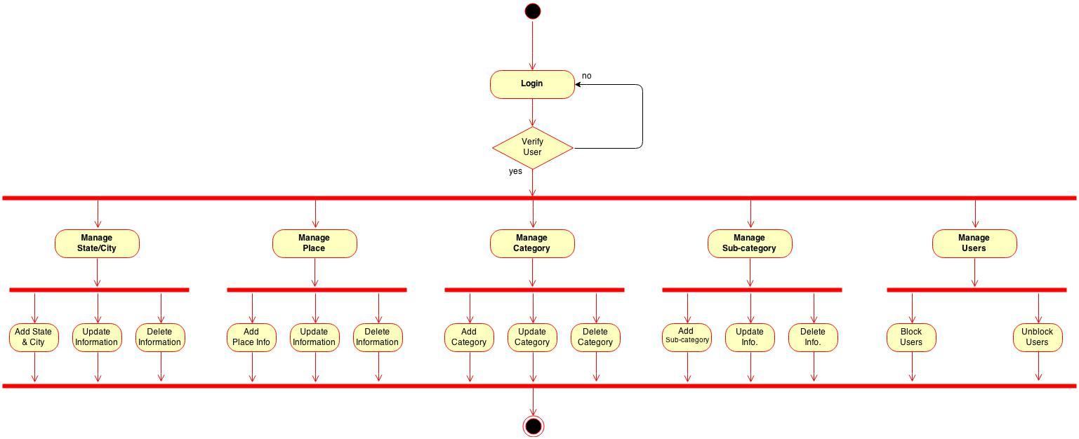
Activity Diagram.

Slide 21
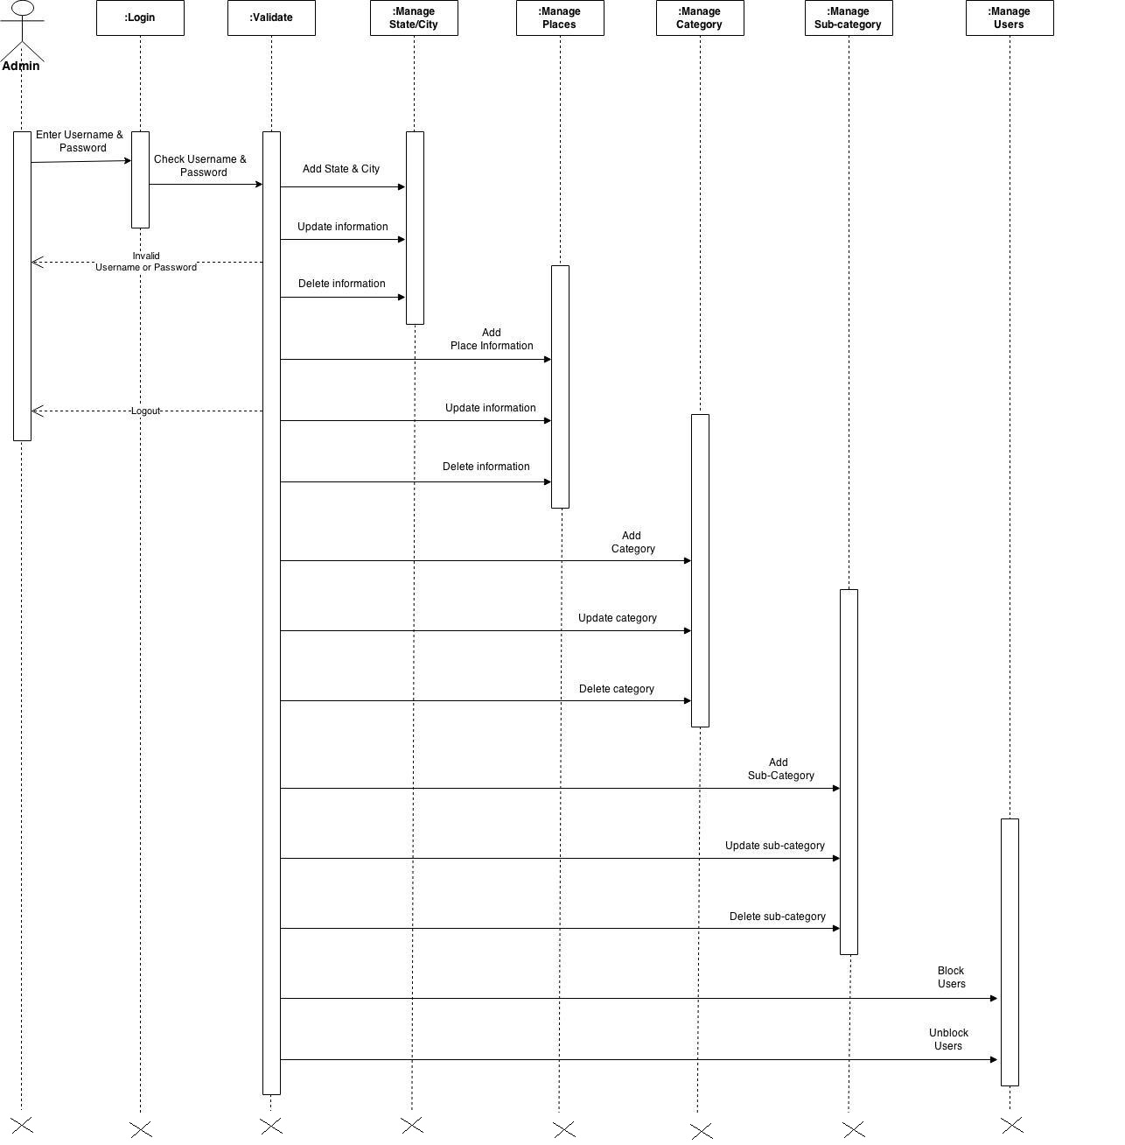
Sequence Diagram.

Slide 22
Client Side
Diagrams

Slide 23
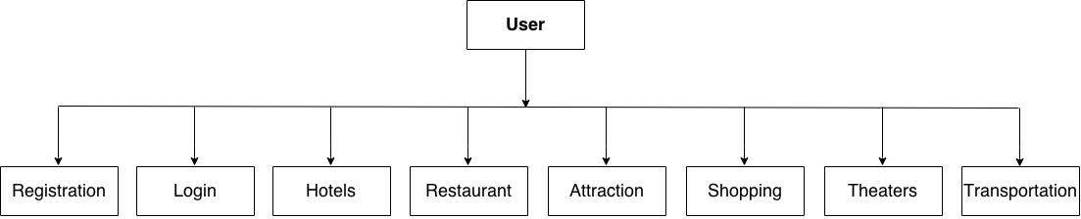
Module Hierarchy.

Slide 24
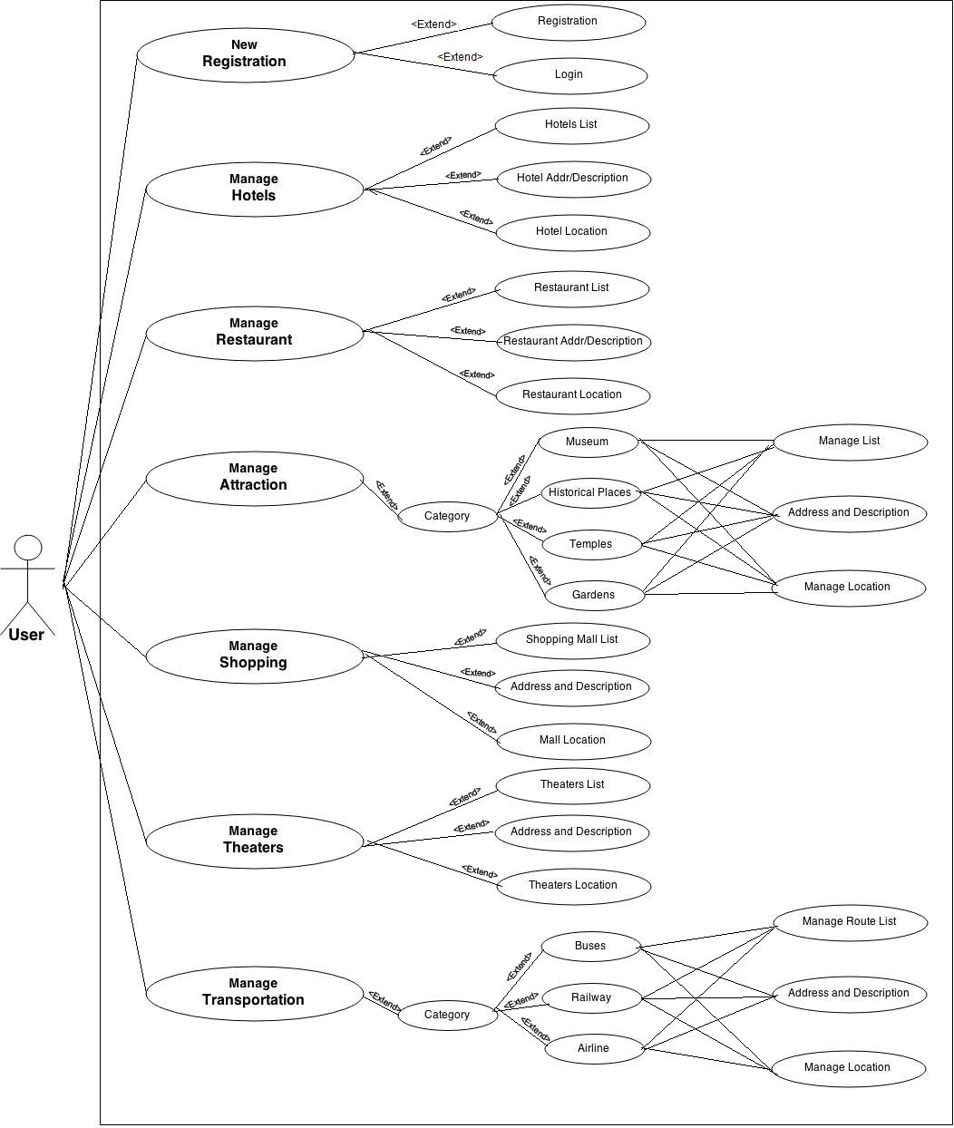
Use case Diagram.

Slide 25
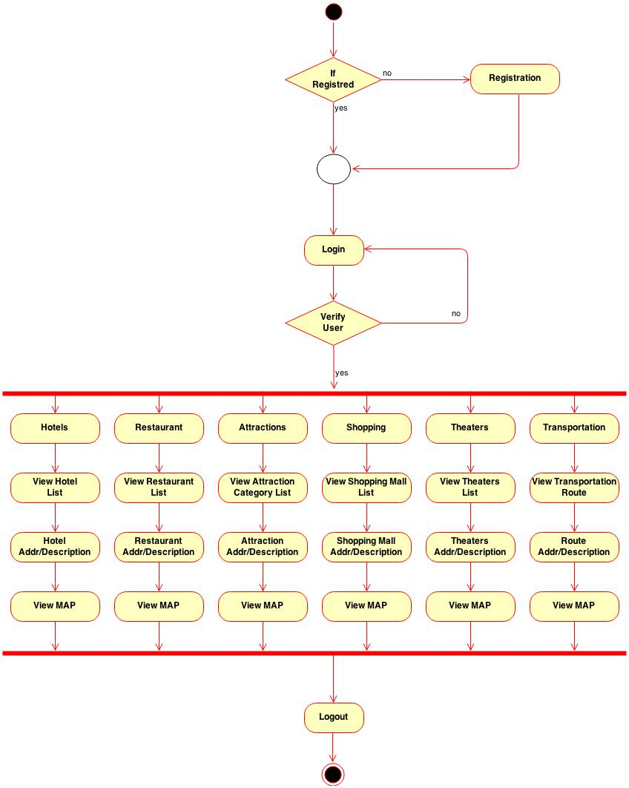
Activity Diagram.

Slide 26
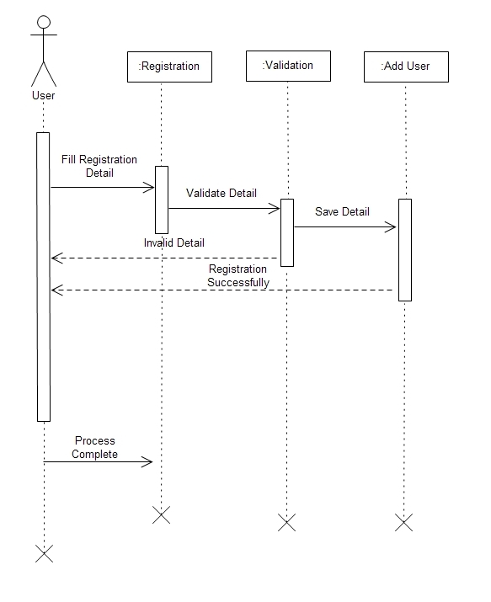
Sequence (Registration User) Diagram.

Slide 27
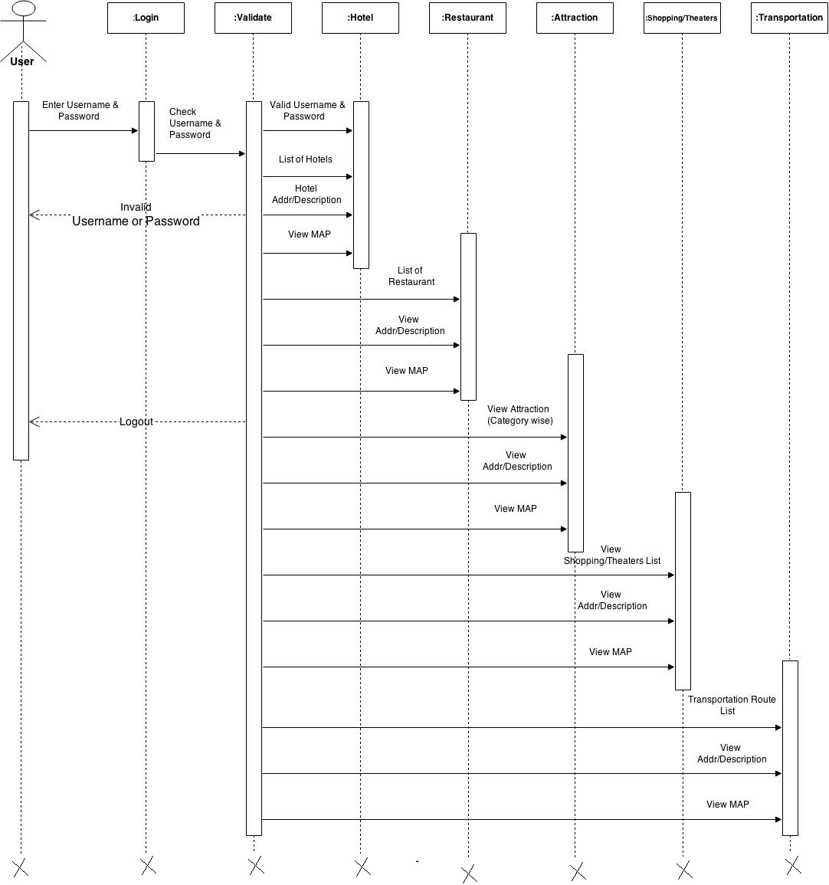
Sequence Diagram.

Slide 28
Data Dictionary

Slide 29
Table 1: Place Master
Column Name | Data type | Constraint | Description
Placid | Integer | Primary Key | Unique Place ID. It is auto increment field
Place category | Integer | Not Null | Cannot be left blank
Place sub-category | Integer | Not Null | Cannot be left blank
Place name | varchar(100) | Not Null | Cannot be left blank
Place state | Integer | Not Null | Cannot be left blank
Place city | Integer | Not Null | Cannot be left blank
Place address | varchar(MAX) | Not Null | Cannot be left blank
Place photo | varchar(200) | Not Null | Cannot be left blank
Place description | varchar(MAX) | Not Null | Cannot be left blank

Slide 30
Table 2: State Master
Column Name | Data type | Constraint | Description
State id | Integer | Primary Key | Unique State ID. It is auto increment field
State name | varchar(50) | Not Null | Cannot be left blank
Table 3: City Master
Column Name | Data type | Constraint | Description
City id | Integer | Primary Key | Unique city ID. It is auto increment field
City name | varchar(50) | Not Null | Cannot be left blank
State id | Integer | Foreign Key | Cannot be left blank

Slide 31
Table 4: Category Master
Column Name | Data type | Constraint | Description
Category id | Integer | Primary Key | Unique category ID. It is auto increment field
Category name | varchar(50) | Not Null | Cannot be left blank
Table 5: Sub-category Master
Column Name | Data type | Constraint | Description
Sub-category id | Integer | Primary Key | Unique category ID. It is auto increment field
Sub-category name | varchar(50) | Not Null | Cannot be left blank
Category id | Integer | Foreign Key | Cannot be left blank

Slide 32
Admin Side
Screen Layouts

Slide 33
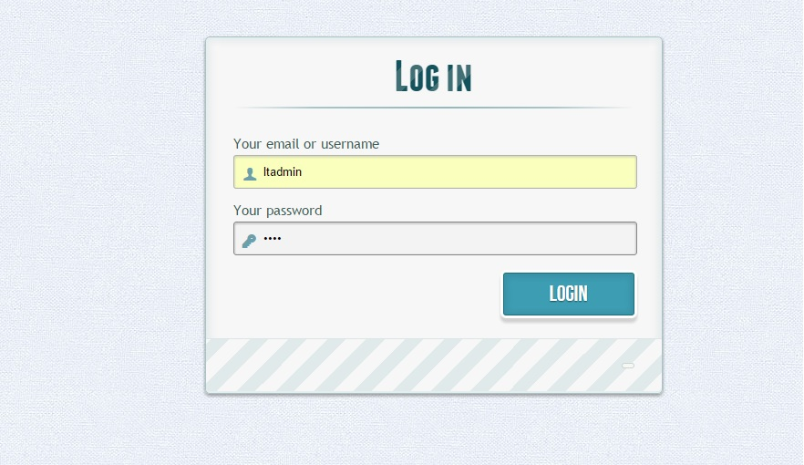
Login Page

Slide 34
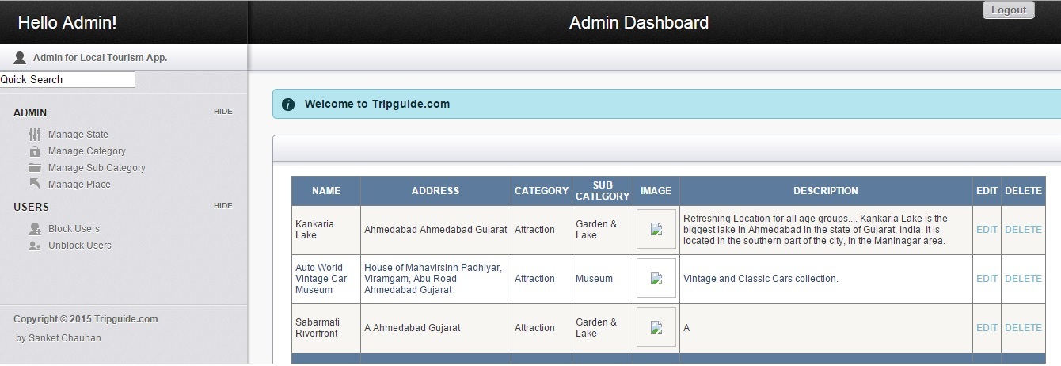
Home Page

Slide 35
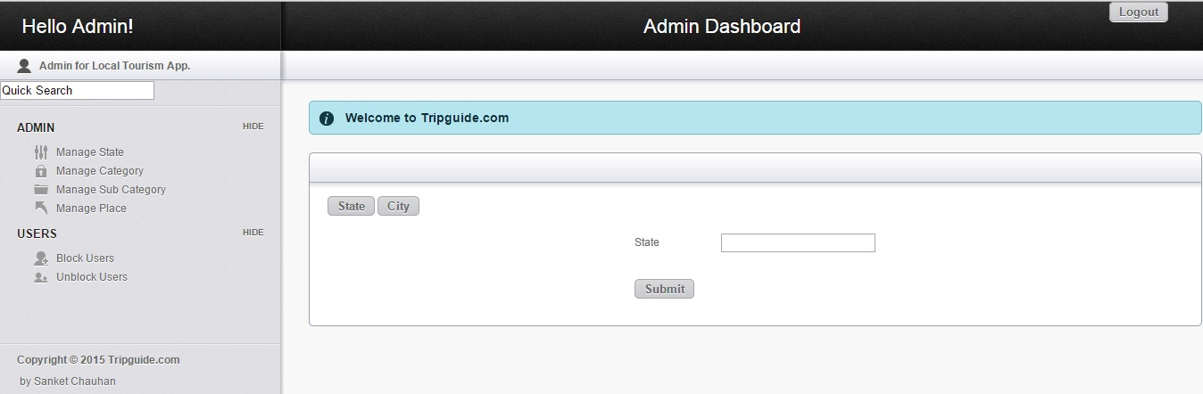
Manage State/City

Slide 36
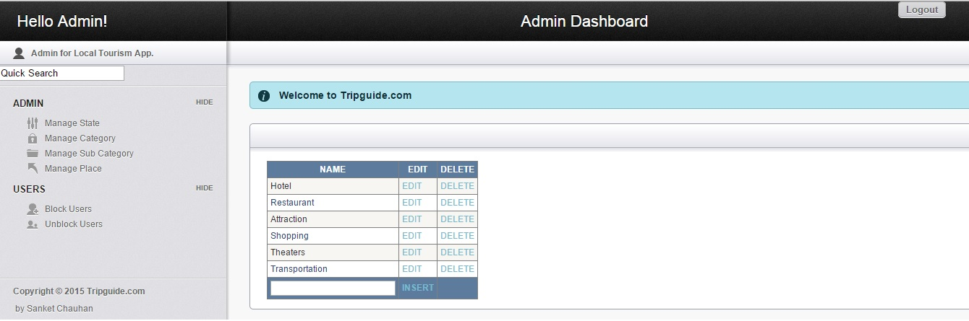
Manage Category

Slide 37
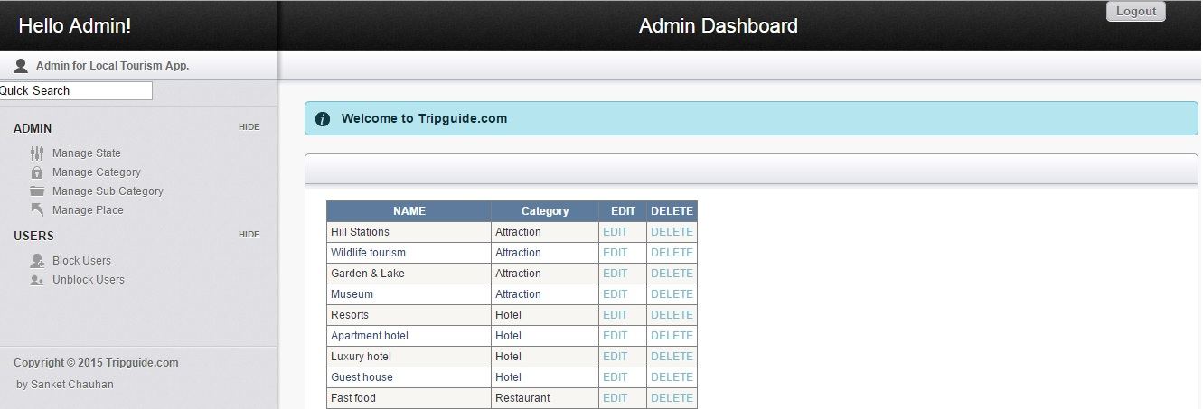
Manage Sub-category

Slide 38
Client Side
Work in Progress…

Slide 39
Thank You ☺

